Slide 1


ENGI 301
VocalVision
Proposal
Sept. 26, 2023
PRESENTED BY
Speaker Identification and Transcription
Parnika Mandewalkar

Slide 2

Implications
Background
Information
This device can have a majority of applications, the intended one being aiding deaf people in the interpretation of large-scale in-person meetings. Generally, it is immensely difficult to follow who is speaking and what they are saying when there are so many people participating in a conversation, so visualizing this onto a display can be of immense help.
What is Vocal Vision?
What would this involve?
VocalVision is a real-time speech interpreter that can listen into meetings or hard-to-follow conversations using one mic and recognize who is speaking as well as transcribe what they are saying onto a display.
Lots of machine learning and data analysis. A mic would be connected to the PocketBeagle to obtain real time data and it would output onto an LCD display. The python libraries used would be tensorflow, keras, librosa, etc. Vocal Classification exists, and so does transcription, but not together just yet!
References
https://towardsdatascience.com/voice-classification-using-deep-learning-with-python-6eddb9580381
https://towardsdatascience.com/audio-deep-learning-made-simple-sound-classification-step-by-step-cebc936bbe5
PocketBeagle Alexa Project (For input audio analysis)

Slide 3

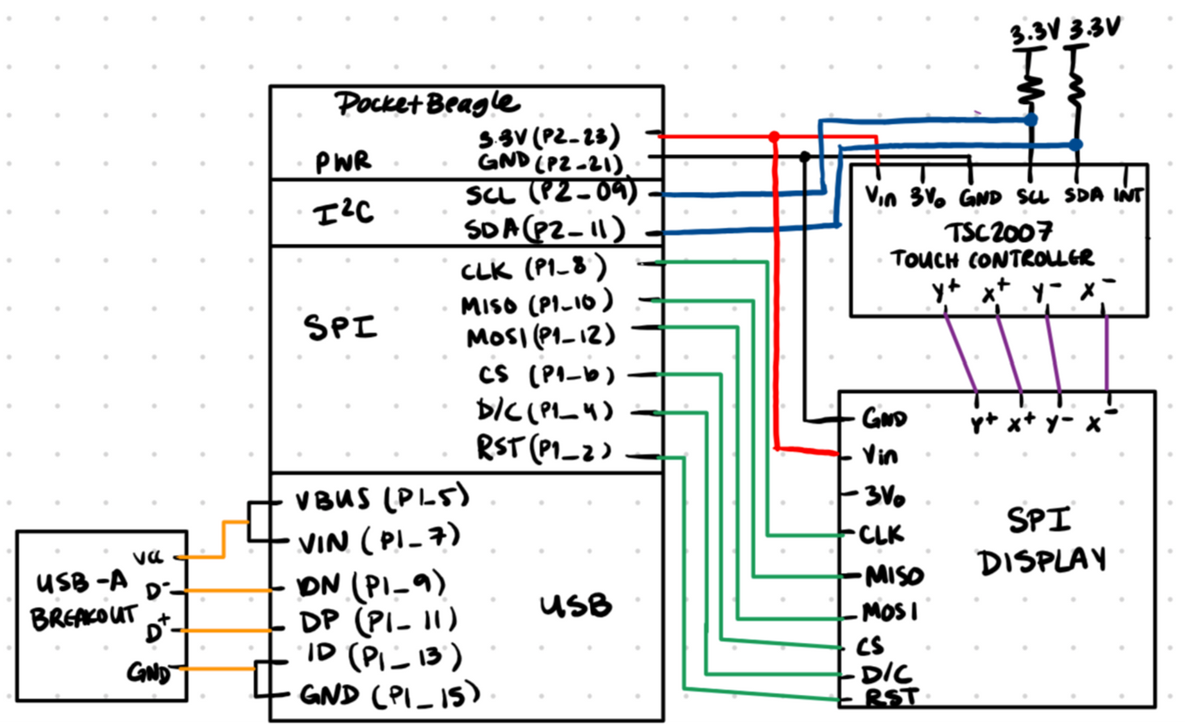
System Block Diagram

Slide 4
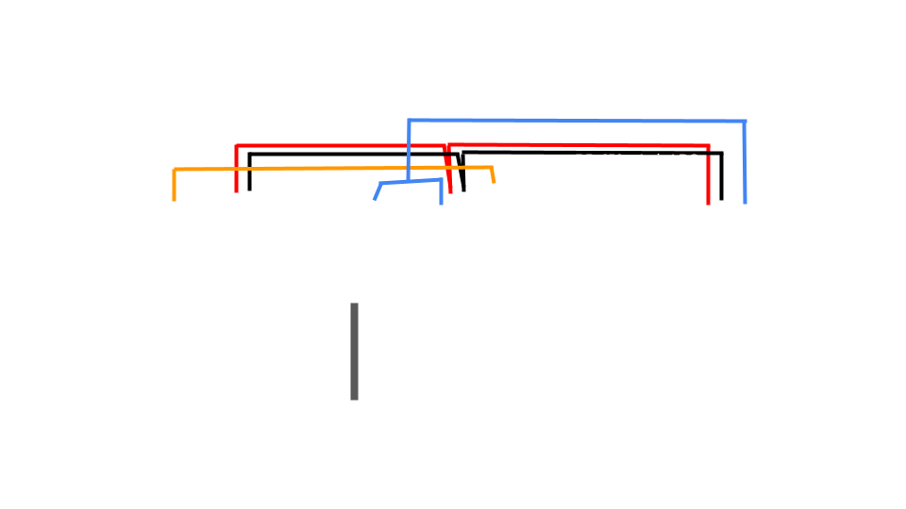
Power Block Diagram
+ Resistive Touchpad

Slide 5


Components/Budget
Part | Value | Link | Buy?
PocketBeagle | - | -
2.8" TFT LCD - ILI9341 (Parts List) | $29.95 | https://www.adafruit.com/product/1770
USB 2.0 Microphone (Parts List) | $7.99 | https://www.amazon.com/gp/product/B01MQ2AA0X
Resistive Touch Controller (Parts List) | $4.95 | https://www.adafruit.com/product/5423
TOTAL |  | $42.89

